Slide 1
Literature Review Team:-Avengers
Arafat Rahman Sakib(221-15-5422)
Avinandan Roy(221-15-4899)
Mst.Habiba Sultana(221-15-5528)
Mst.Jannati Nahid Akter(221-15-5523)
Ahmed Al Rakib(221-15-5652)

Slide 2



Paper context
Explainable AI
Discuss about all techniques of Explanations AI with model
Developing an explainable artificial intelligence model
Applications of machine learning in health care
importance of Explainable Artificial Intelligence (XAI) in predictive modeling in healthcare

Slide 3
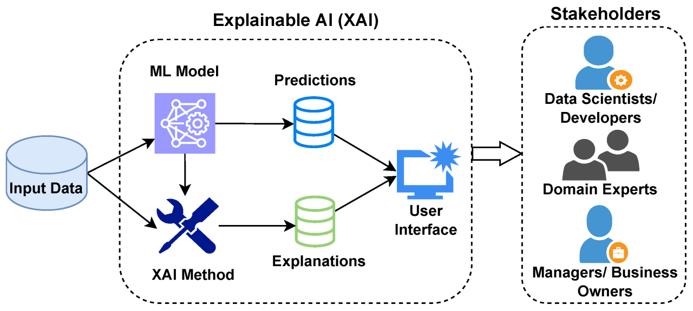
2021 :Marzyeh Ghassemi :
Approaches of explainable AI
Pneumonia
Image dataset
Best Model : Lime, shap
Transparency in decision-making processes
lack performance guarantees and rigorous testing
2021 :Giulia Vilone:
discussing the notions of explainability and evaluation approaches
review studies in XAI, focusing on conceptual and theoretical aspects
The lack of consensus among scholars on how to define an explanation

Slide 4

2020 :Simon Meyer Lauritsen :
developing an explainable artificial intelligence model
kidney injury,
163050 Numeric dataset
Working with XAI-EWS
Accuracy 0.88 to 0.92
early prediction of acute critical illness from electronic health records
limiting its generalizability to other populations
2020 :Christine M. Cutillo:
collaboration in the implementation of Machine Intelligence
Working with quality and quantity
application of Machine Intelligence (MI) in healthcare
Working with XAI-EWS
Accuracy 90%
Lack :potential challenges in communication and understanding within the field

Slide 5

2020 :Christopher C. Yang:
Importance of Explainable Artificial Intelligence (XAI) in predictive modeling in healthcare
Diabetes, sepsis, and diabetic retinopath
The application of artificial intelligence and machine learning algorithms, particularly deep learning, in predictive modeling within the healthcare domain
It highlights the opacity of deep learning models, which lack explicit declarative knowledge representation, making it difficult to generate underlying explanation structures

Slide 6

Paper Context
1.“Explainable Al meets Healthcare: A Study on Heart Disease Dataset (2020)“
2. Unveiling Key Predictors for Early Heart Attack Detection using Ma
chine Learning and ΧΑΙ Technique LIME.(2020)
3. Heart Attack Prediction using Machine Learning and XAI(2022).
4. XAI–reduct: accuracy preservation despite dimensionality reduction for heart disease classifcation using explainable AI.
5. Explainable, Domain-Adaptive, and Federated Artificial Intelligence in Medicine
Disease Name: Heart Disease.

Slide 7
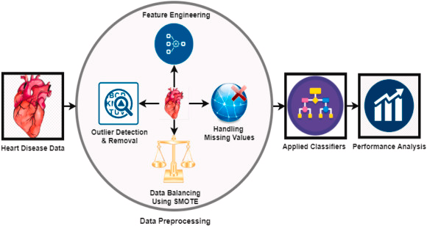
1. Devam Dave,Het Naik , Smiti Singhal (2020)
In this paper the author studies how Explainable AI (XAI) might enhance the reliability and availability of AI-based healthcare systems for health care
Domain:-Explainable Artificial Intelligence
Best model:-LIME and SHAPE
Study feature-based and example based explainable AI in techniques in healthcare.
Limitation:-Lack of explainability restricts AI deployment in healthcare
In this paper this study aimed at a significant level of efficiency in heart attack prediction using ML including LGBM
Healthcare and Artificial Intelligence (AI)
Perform work:-This research compares machine learning algorithms for heart attack prediction and uses LIME to explain key factors like "kcm" and "troponin" influencing all models predictions.
Accuracy:-99.33%
2. Mohan Bhandari(2020)

Slide 8
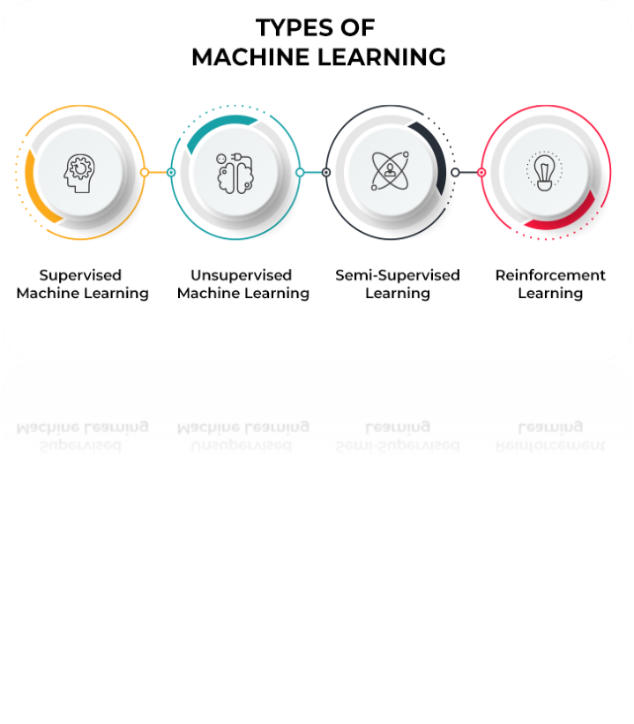
3.Mumtahina Ahsan(2022)
The objective of this paper was to describe the use of machine learning models to predict heart attacks, Method:-LIME method on the KNN ML algorithm.
Accuracy:-86.89%
Limitation:-Limited dataset hinders XGBoost explicability with SHAP/LIME
4. Surajit Das(2022)
Explanations from SHAP to reduce dimensions for heart disease classification with XGBoost while maintaining accuracy.
Heart disease classification using AI
Explainable AI domain adaptation and transfer learning
Future Work:-It was further observed that the classifcation done using the reduced feature vector exhibited much better results too.

Slide 9

5.Ahmad Chaddad(2022)
This paper reviews 3 challenges in applying AI to medicine: lack of interpretability, domain shift, and data privacy
Dataset type:-Image
AI in medicine
Limit:-limitations in interpretability (a), domain shift (b), and data privacy for federated learning (c).

Slide 10
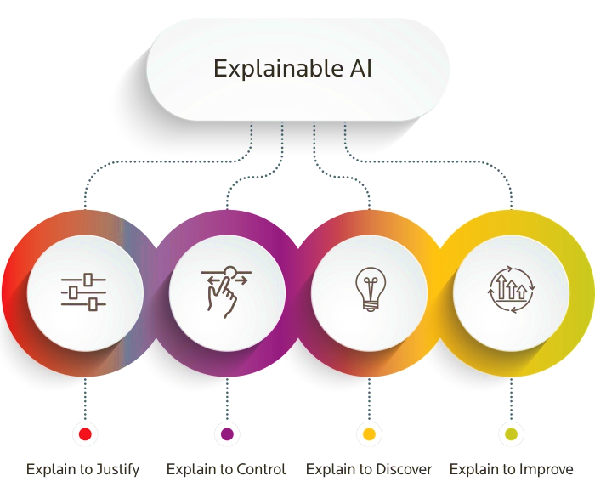
Papers Context
Focuses on designing an evaluation framework for eXplainable AI (XAI) in the healthcare domain .It aims to understand how explanations of AI predictions affect the user experience in terms of satisfaction, understanding, trust, reliability, adoption propensity and task performance .

Slide 11

Mohanad Alsaleh
Ivania Donoso-Guzmán
Upol Ehsan
Vikas Shenoy Pete
Enayat Rajabi

Slide 12
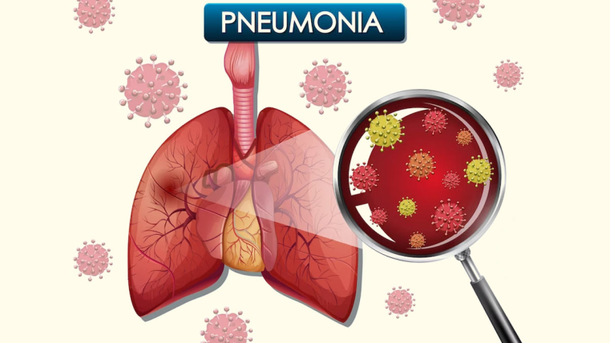
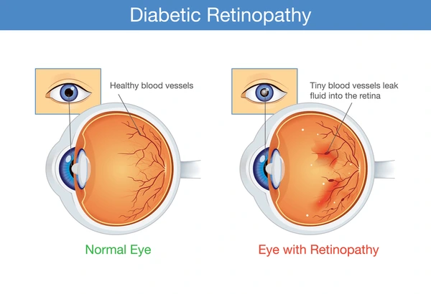
Disease Name
Risk of Pneumonia
Diabetic Retinopathy

Slide 13
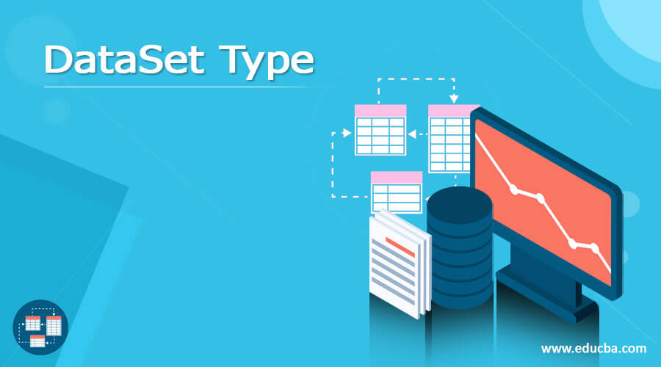
Text
Image
Tabular
Fundus Images

Slide 14
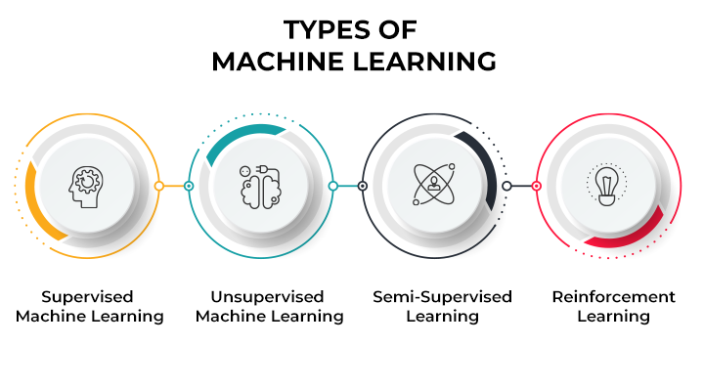
Domain of Papers
The research paper falls within the domain of healthcare and precision medicine, aiming to improve patient outcomes by predicting disease comorbidities using ML techniques.

Slide 15
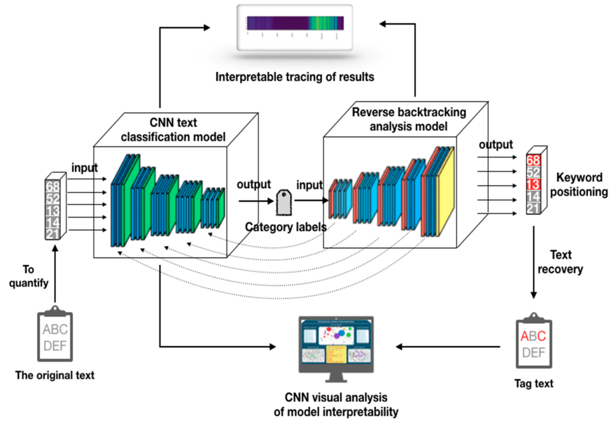
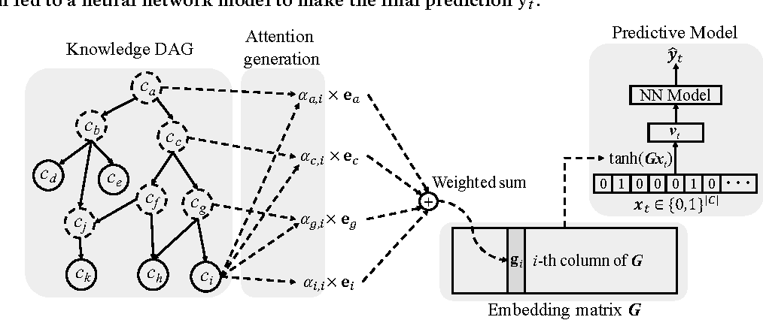
Best Model
Convolutional Neural Network (CNN)
GRAM (Graph-based Attention Model for Healthcare Representation Learning)

Slide 16

Finding and Contribution
Highlighted the potential of Machine learning in predicting comorbidities which can lead to improved patient care and identification of unmet health needs and aims to propose an evaluation framework for XAI-generated explanations in healthcare applications, enhancing user experience and potentially increasing the deployment of AI applications in the healthcare domain.

Slide 17

Limitation
Limited scope of comorbidities analyzed due to restricted phenotypic and genetic data availability , Lack of standard evaluation for explainable artificial intelligence (XAI) hindering fair comparisons.

Slide 18

Explainable AI in Healthcare Helping Doctors Make Better Decisions
we will discuss the use of explainable AI (XAI) in healthcare. XAI is a type of artificial intelligence (AI) that can explain its decisions to humans. This is important in healthcare, where doctors need to understand why an AI system is making a particular recommendation before they can trust it. We will see how XAI can be used to improve the accuracy, transparency, and trust of AI systems in healthcare.

Slide 19

XAI-ICP: Interpretable Pneumonia Diagnosis
XAI system for diagnosing pneumonia from chest X-rays.
Explains its decisions in a clear and understandable way.
Adapts to data from different regions for improved accuracy.
Continuously learns and improves as it processes more data.
We introduces XAI-ICP, an AI system designed to diagnose pneumonia from chest X-rays. XAI-ICP uses advanced AI technology that explains its decisions, making it easier for doctors to trust and understand how it works. XAI-ICP can adapt to data from different regions and improves its accuracy over time.

Slide 20

Evaluating XAI: Explaining AI for Diabetes Management
Study on how AI explanations affect diabetes patients.
Compares rule-based and example-based explanations.
Explains AI decisions can lead to patients trusting bad advice.
Neither explanation type improved how patients managed diabetes.
We discuss how AI explanations affect diabetes patients managing their condition. It compares rule-based and example-based explanations to see if they help patients understand AI better, follow its advice, and manage diabetes more effectively. The results show that rule-based explanations slightly improve understanding but neither type helps improve how well patients manage their diabetes. Both types make patients more likely to follow the AI's advice, even if it's incorrect.

Slide 21

Explainable AI for Bioinformatics
Importance of making AI decisions understandable in healthcare.
Reviews methods for making AI more transparent in bioinformatics.
Tools and applications for analyzing medical images and cancer genetics.
Difficulty in adapting AI explanations to specific healthcare tasks.
We discusses the importance of making AI decisions easy to understand, especially in bioinformatics, which deals with AI in healthcare. The paper reviews methods that make AI more transparent and shows how these methods can be used in bioinformatics tasks like analyzing medical images, studying cancer genetics, and mining medical texts.

Slide 22

ECG Monitoring with Federated Transfer Learning and Explainable AI
New system for detecting heart problems using ECG data.
Utilizes federated learning to keep patient data secure.
Offers clear explanations for its decisions to build trust with doctors.
Achieved high accuracy in tests, effectively identifying heart issues.
We presents a new system for detecting heart problems (arrhythmias) using ECG (heart monitoring) data, utilizing advanced AI techniques. This system uses a special approach called federated learning, which helps keep patient data private. It explains its decisions clearly, making it easier for doctors to trust and understand. The system performed very well in tests, proving it can accurately identify heart issues.

Slide 23

Paper names and disease name
1. Focus Group on artificial intelligence for health (2018)
2. Predicting heart attack through explainable artitificial intelligence (2019)
3. Explainable artificial intelligence for neuro science (2019)
4.Current applications of artificial intelligence for intraoperative decision support in surgery(2020)
5.Improvement of a prediction model for heart failour survival through explainable artificial intelligence (2023)
DISEASE NAME
ICD
Heart Attacks
Epilepsy major depression
Not mentioned
Heart failour.

Slide 24

1. Marcel Salathe (2018)
Dataset type FG-AI4H
Best model: standardized benchmarking
High accuracy.
The FG-AI4H identifies and addresses the potential and challenges of AI in healthcare. It contributes by developing standardized frameworks to evaluate AI methods globally.
Limitations: limitations in AI for health include data privacy concerns, interpretability of models, and access to high-quality training data.

Slide 25

2. Mehrdad Aghamohammadi(2019)
Dataset used in the study is "Cleveland.“
Best model: The best model mentioned in the study is the "ANFIS-GA" model.
Accuracy 82.5%.
The study introduces a novel AI model combining ANFIS and Genetic Algorithms to accurately predict heart attacks, enhancing medical diagnostics with explainable results. This approach identifies key features impacting diagnosis, thereby improving healthcare decision-making.
Limitations: The study's limitations include its reliance on a specific dataset (Cleveland), which may not generalize to other populations or conditions. Additionally, the complexity of the ANFIS-GA model may require substantial computational resources, limiting its practicality in some settings

Slide 26
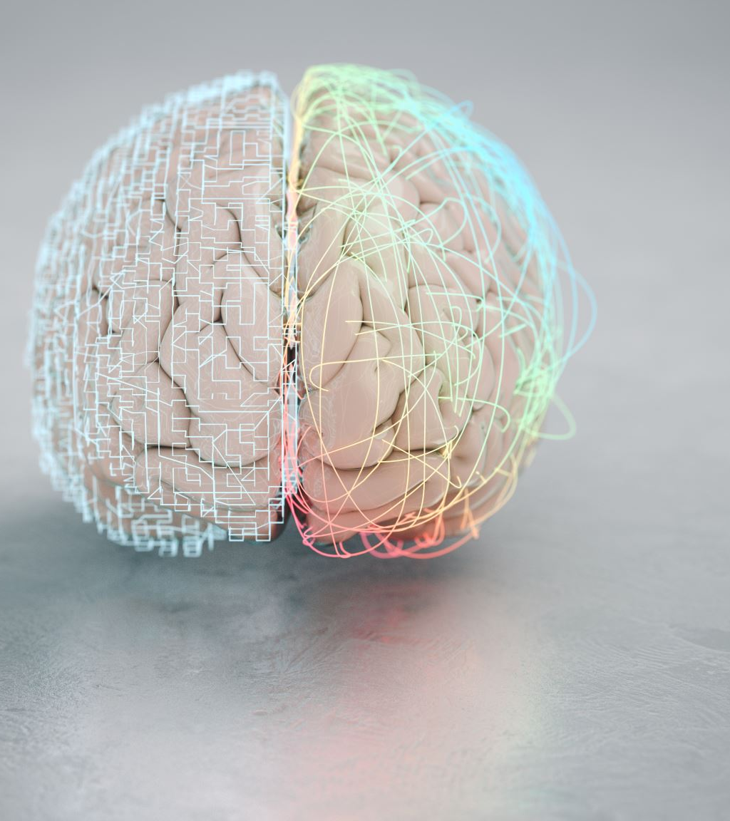
3. Jean-Marc Fellous(2019)
Dataset Neural,Behavioral,Multimodal,Clinical
Best model:
1. XAI models(Explainable Artificial Intelligence models)
2. Hybrid explainable modelsAccuracy 82.5%.
The manuscript discusses the integration of Explainable Artificial Intelligence (XAI) with neurostimulation to improve real-time understanding and manipulation of neural circuits for mental health applications.
Limitations: The manuscript acknowledges limitations in the current understanding of neural mechanisms, data insufficiency, and the complexity of translating explainable AI models from theory to practical, clinical applications

Slide 27

4. Allison J.Navarrete-Welton(2020)
Dataset Structured datasets, Unstructured datasets, Semi structured, Time series .
Best model: data science, machine learning, or statistical analysis
This research contributes to the field by demonstrating the practical benefits of AI in healthcare, providing a roadmap for its broader adoption to improve patient outcomes
Limitations: This study's findings are limited by the small, non-diverse sample size and the short duration of the trial, which may not fully represent long-term effects or broader applicability.

Slide 28

5. Mario Mekhael(2023)
Dataset The main word describing the dataset type in this context is "clinical"
Best model: The main word describing the best model in this context is "Random Forest."
The study's key finding and contribution is the development of explainable prediction models for heart failure survival that balance accuracy and interpretability, potentially improving clinical decision-making and patient outcomes.
Limitations: The main limitations of the study include the dataset's regional specificity to an urban area in Pakistan, which may not generalize to other populations, and the imbalance in the target feature, which could bias the model's performance.

